Slide 1

Topic: 2nd Law of Thermodynamics
Lecture – 9
Disclaimer:
The study materials/presentations are solely meant for academic purposes and they can be reused, reproduced, modified, and distributed by others for academic purposes only with proper acknowledgements.

Slide 2
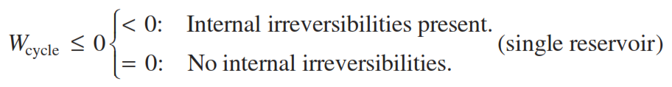
    A reversible process is the limiting case as irreversibilities, both internal and external, are reduced further and further.
    An internally reversible process is one for which there are no irreversibilities within the system. Irreversibilities may be located within the surroundings, however.
    Interpreting the Kelvin–Planck Statement:
    We assume that the thermal reservoir and the portion of the surroundings with which work interactions occur are free of irreversibilities.
    Accordingly, the analytical form of the Kelvin–Planck statement now takes the form

Slide 3
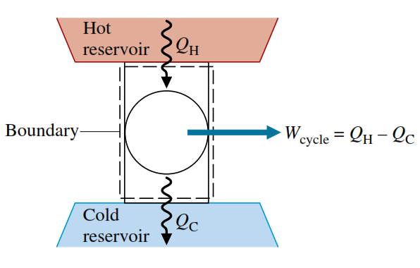
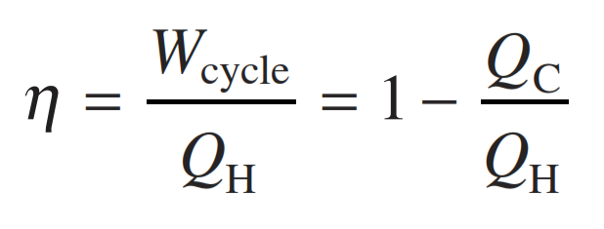
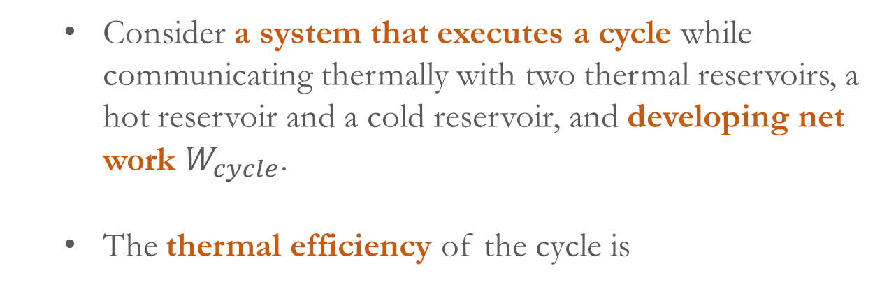
    Applying the Second Law to thermodynamic Cycles:
    Now, applications of the second law to power cycles and refrigeration and heat pump cycles are considered.
    Review the thermal efficiency of power cycles and coefficients of performance for refrigeration and heat pump systems.
    Consider a system that executes a cycle while communicating thermally with two thermal reservoirs, a hot reservoir and a cold reservoir, and developing net work $W_{cycle}$.
    The thermal efficiency of the cycle is

Slide 4
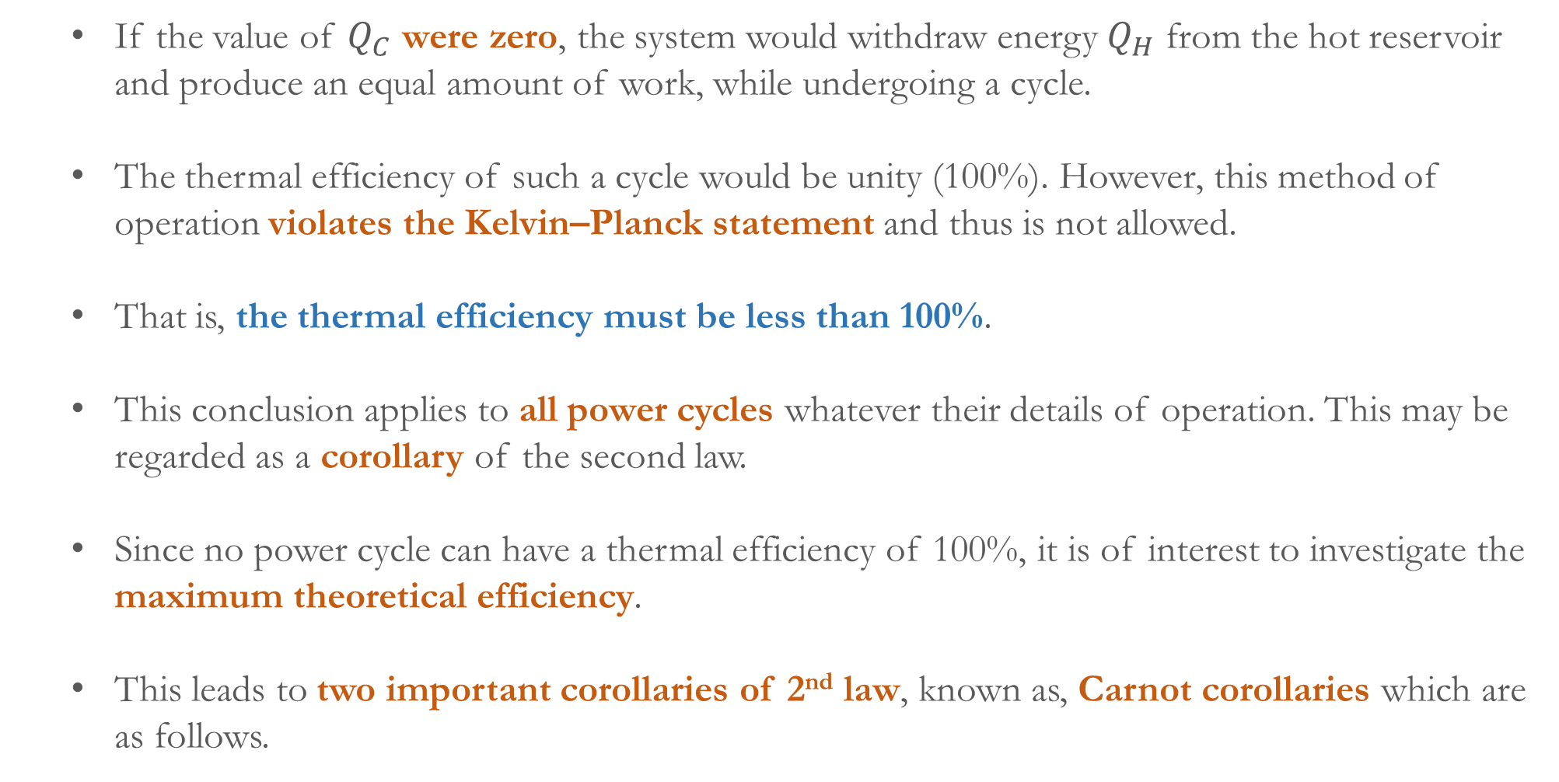
    If the value of $Q_{C}$ were zero, the system would withdraw energy $Q_{H}$ from the hot reservoir and produce an equal amount of work, while undergoing a cycle.
    The thermal efficiency of such a cycle would be unity (100%). However, this method of operation violates the Kelvin–Planck statement and thus is not allowed.
    That is, the thermal efficiency must be less than 100%.
    This conclusion applies to all power cycles whatever their details of operation. This may be regarded as a corollary of the second law.
    Since no power cycle can have a thermal efficiency of 100%, it is of interest to investigate the maximum theoretical efficiency.
    This leads to two important corollaries of 2nd law, known as, Carnot corollaries which are as follows.

Slide 5
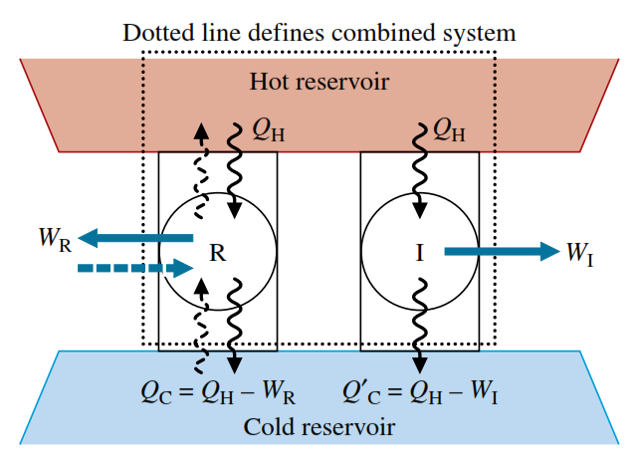
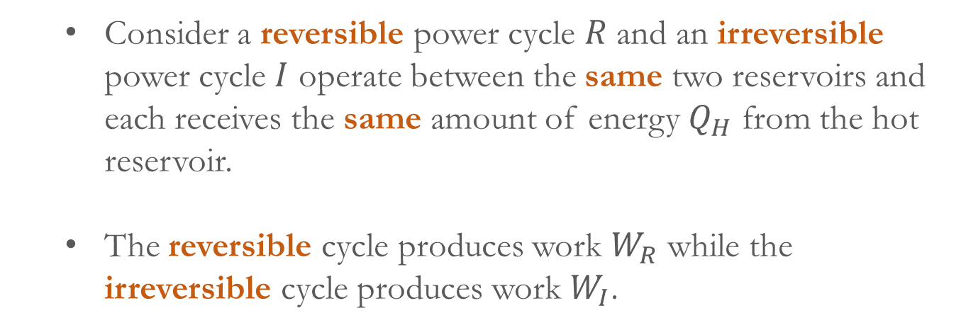
    (1) The thermal efficiency of an irreversible power cycle is always less than the thermal efficiency of a reversible power cycle when each operates between the same two thermal reservoirs.
    (2) All reversible power cycles operating between the same two thermal reservoirs have the same thermal efficiency.
    Consider a reversible power cycle $R$ and an irreversible power cycle $I$ operate between the same two reservoirs and each receives the same amount of energy $Q_{H}$ from the hot reservoir.
    The reversible cycle produces work $W_{R}$ while the irreversible cycle produces work $W_{I}$.
    Let $R$ now operate in the opposite direction as a refrigeration (or heat pump) cycle.

Slide 6


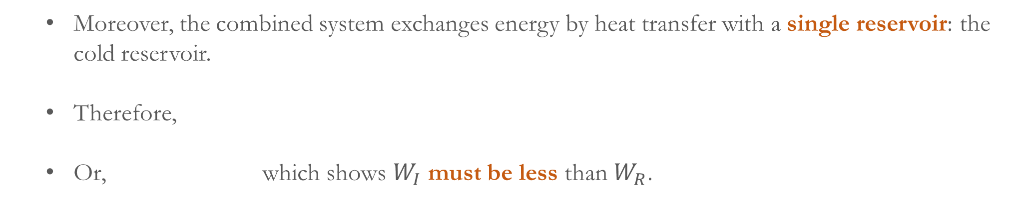
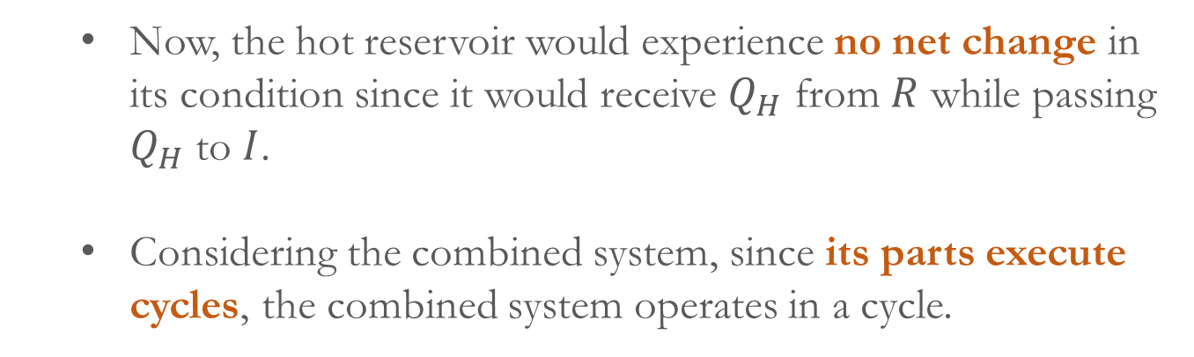
    Since $R$ is reversible, the magnitudes of the energy transfers $W_{R}$, $Q_{H}$, and $Q_{C}$ remain the same, but the energy transfers are oppositely directed.
    Now, the hot reservoir would experience no net change in its condition since it would receive $Q_{H}$ from $R$ while passing $Q_{H}$ to $I$.
    Considering the combined system, since its parts execute cycles, the combined system operates in a cycle.
    Moreover, the combined system exchanges energy by heat transfer with a single reservoir: the cold reservoir.
    Therefore,
    Or, which shows $W_{I}$ must be less than $W_{R}$.

Slide 7
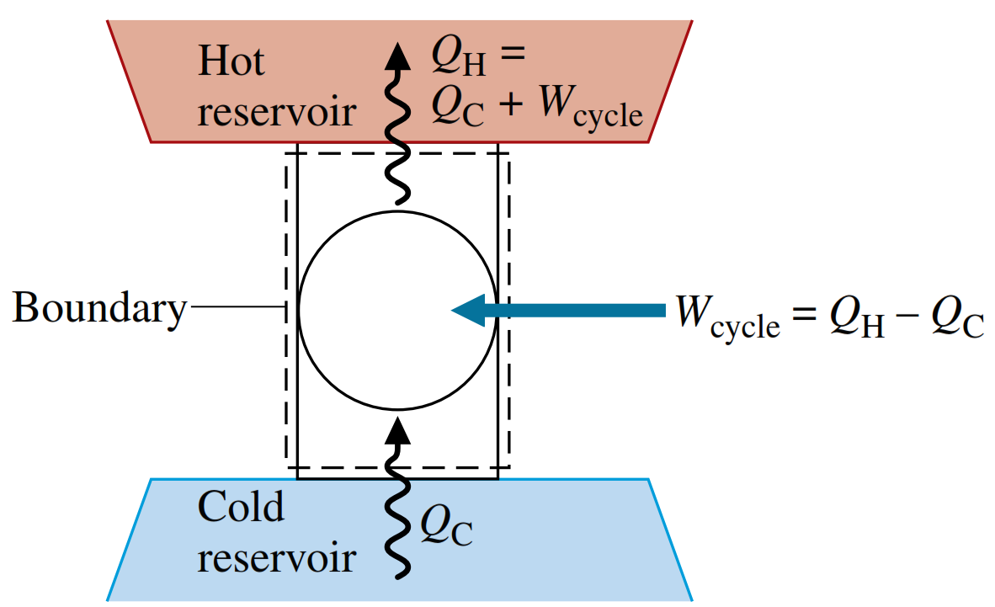
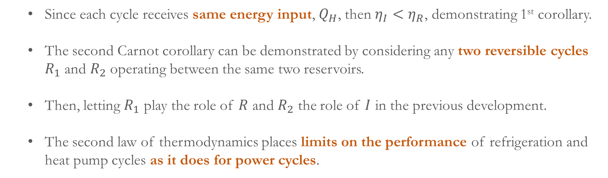
    Since each cycle receives same energy input, $Q_{H}$, then $η_{I}<η_{R}$, demonstrating 1st corollary.
    The second Carnot corollary can be demonstrated by considering any two reversible cycles $R_{1}$ and $R_{2}$ operating between the same two reservoirs.
    Then, letting $R_{1}$ play the role of $R$ and $R_{2}$ the role of $I$ in the previous development.
    The second law of thermodynamics places limits on the performance of refrigeration and heat pump cycles as it does for power cycles.
    The figure shows a system undergoing a cycle while communicating thermally with two thermal reservoirs, a hot and a cold reservoir.
    This cycle might be a refrigeration cycle or a heat pump cycle, depending on its function.

Slide 8
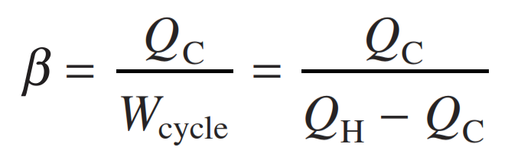
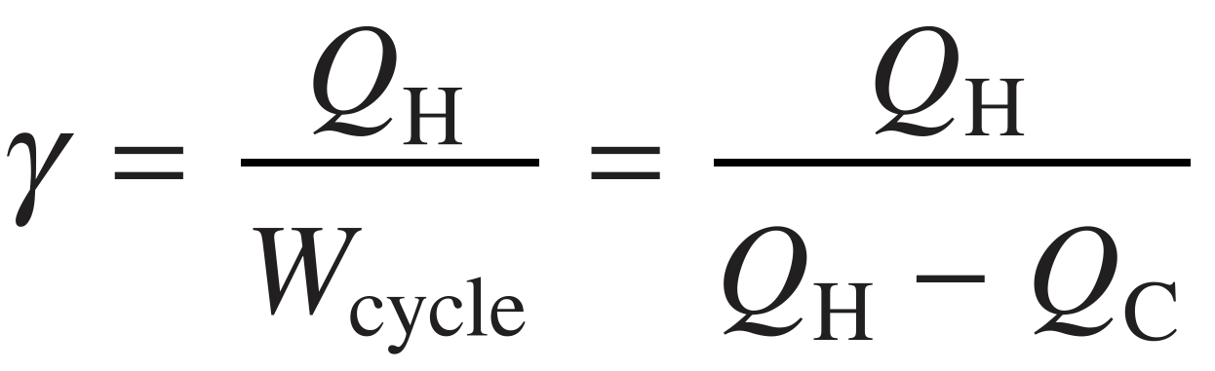
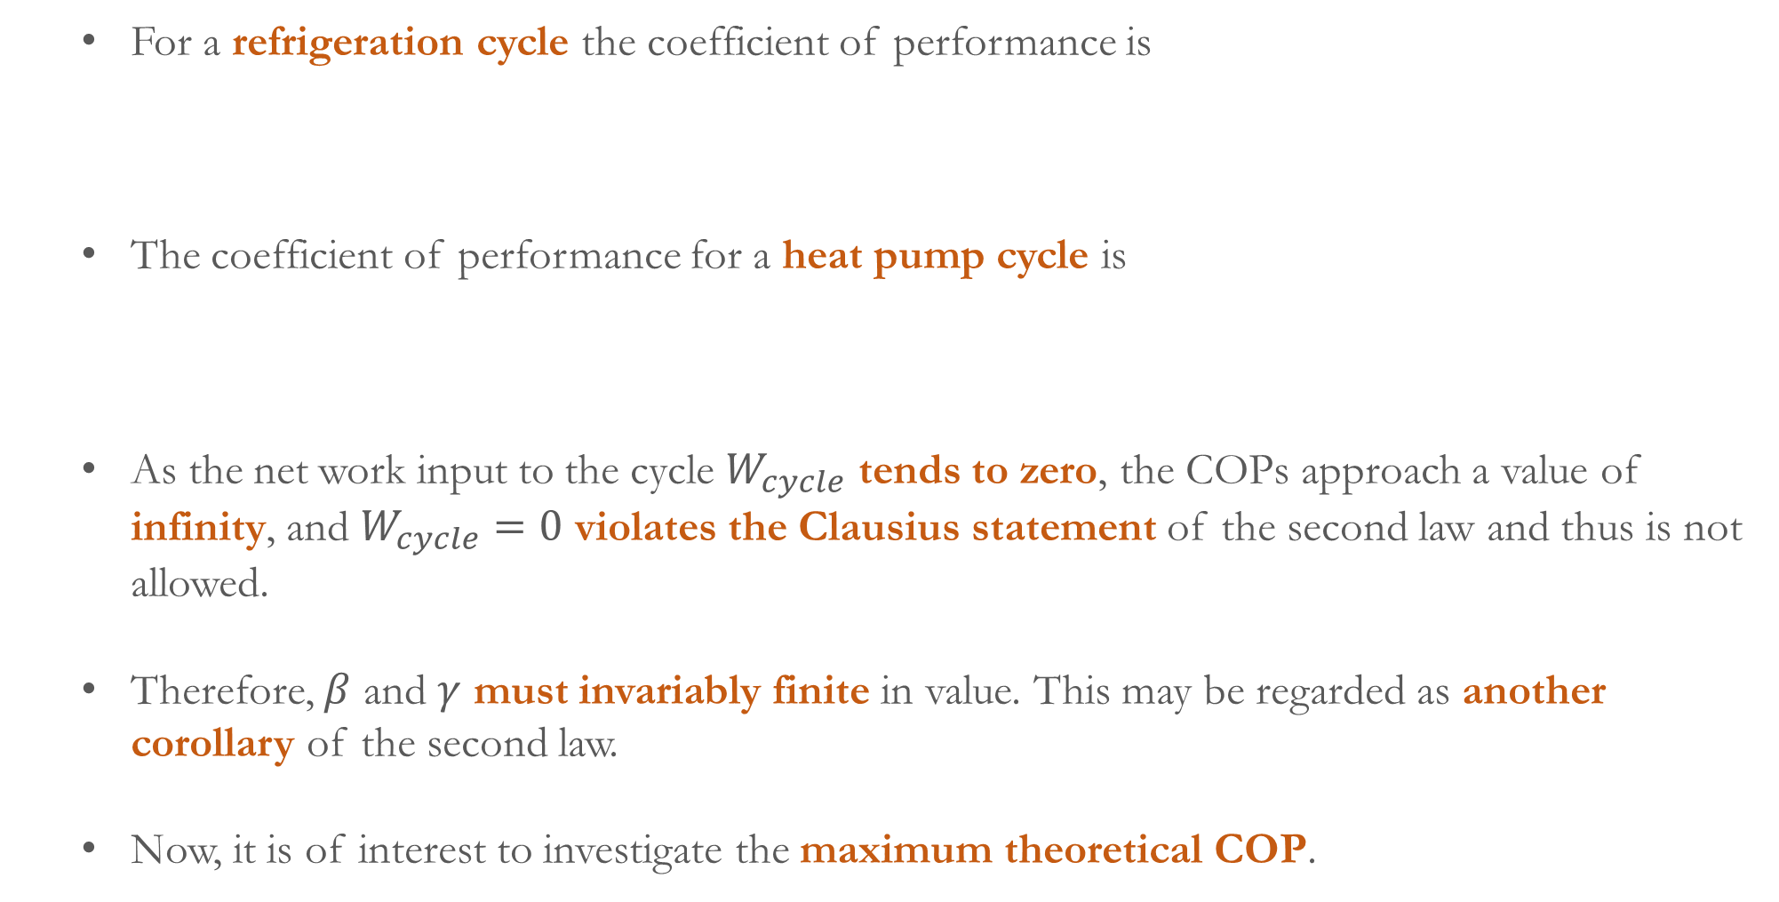
    For a refrigeration cycle the coefficient of performance is
    The coefficient of performance for a heat pump cycle is
    As the net work input to the cycle $W_{cycle}$ tends to zero, the COPs approach a value of infinity, and $W_{cycle}=0$ violates the Clausius statement of the second law and thus is not allowed.
    Therefore, $β$ and $γ$ must invariably finite in value. This may be regarded as another corollary of the second law.
    Now, it is of interest to investigate the maximum theoretical COP.

Slide 9
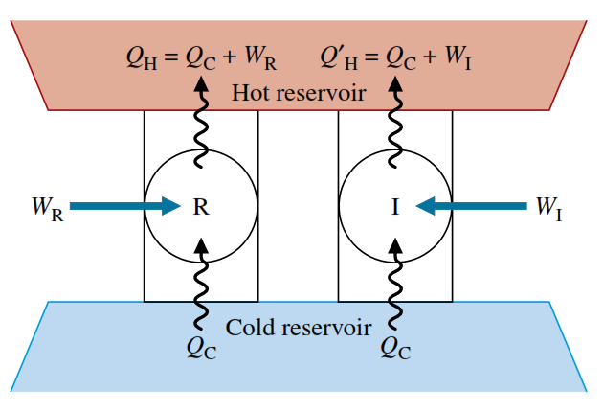
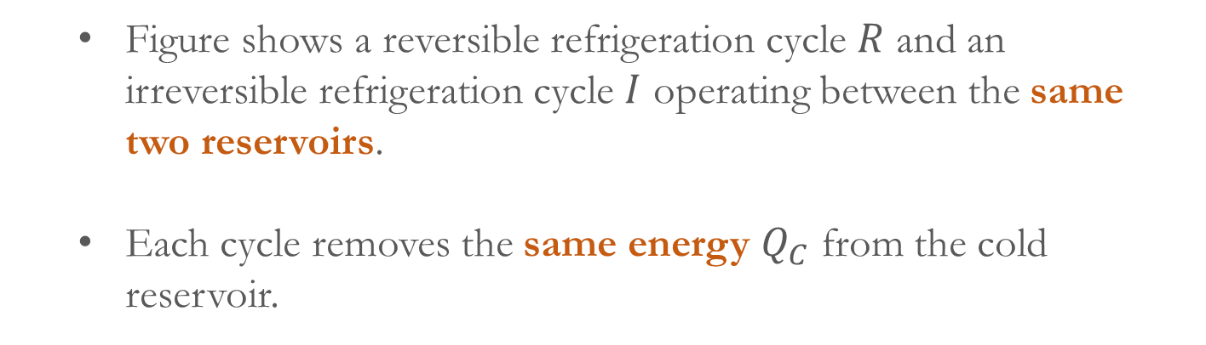
    This leads to two other important corollaries of 2nd law.
    (1) The COP of an irreversible refrigeration cycle is always less than the COP of a reversible refrigeration cycle when each operates between the same two thermal reservoirs.
    (2) All reversible refrigeration cycles operating between the same two thermal reservoirs have the same COP.
    Figure shows a reversible refrigeration cycle $R$ and an irreversible refrigeration cycle $I$ operating between the same two reservoirs.
    Each cycle removes the same energy $Q_{C}$ from the cold reservoir.
    If one executes a reversible cycle while the other executes an irreversible cycle, we expect the irreversible cycle to require a greater net work input and thus have the smaller COP.

Slide 10
    By a simple extension, it follows that all reversible refrigeration cycles operating between the same two reservoirs have the same COP.
    These corollaries can be demonstrated formally using the Kelvin–Planck statement and a procedure similar to that employed for the Carnot corollaries.
    Kelvin scale:
    The concepts of maximum theoretical thermal efficiency and maximum theoretical COP are developed using the Kelvin temperature scale.
    From the second Carnot corollary, we can say the value of thermal efficiency can be related only to the nature of the reservoirs themselves.
    As the difference in temperature between the two reservoirs causes heat transfer between them, we reason that the thermal efficiency depends only on the temperatures of the two reservoirs.

Slide 11
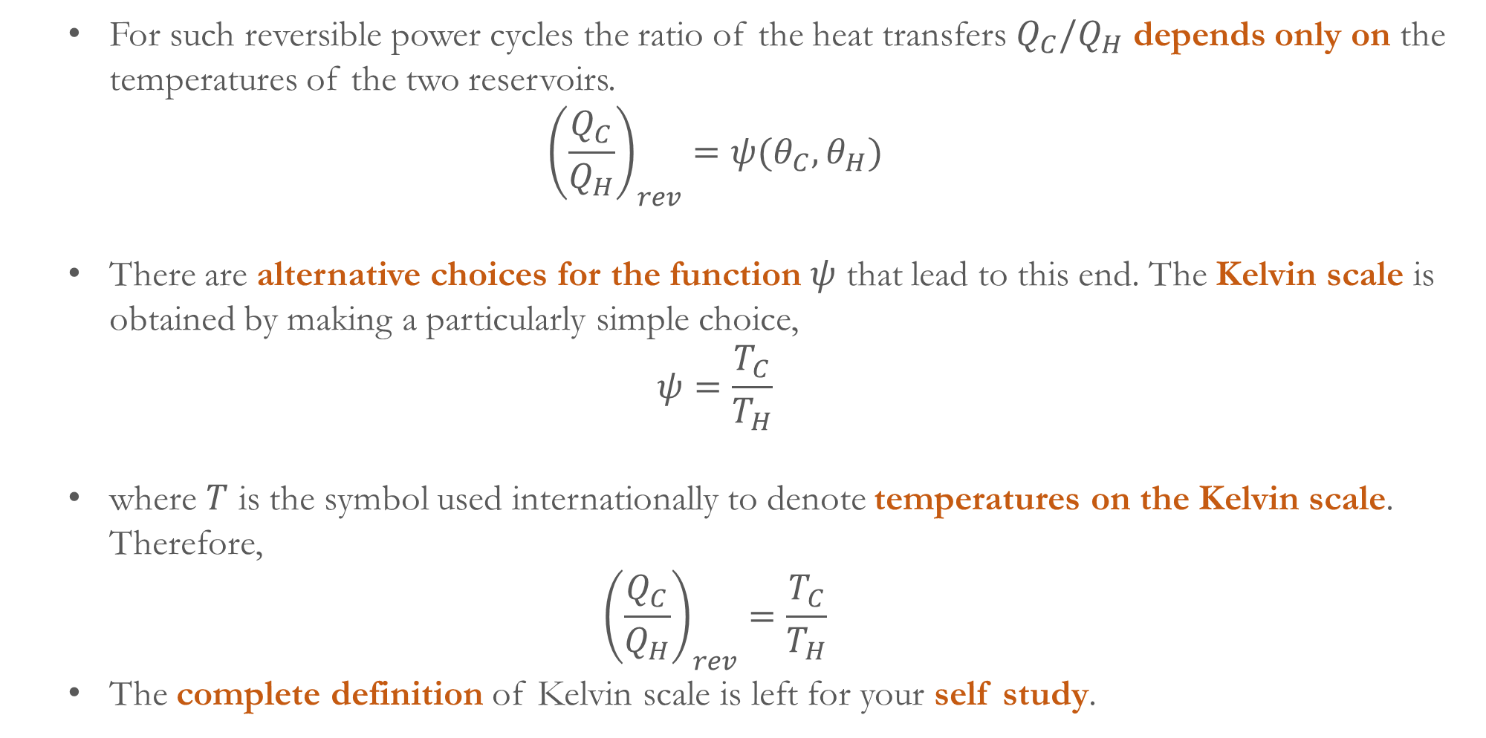
    For such reversible power cycles the ratio of the heat transfers $Q_{C}/Q_{H}$ depends only on the temperatures of the two reservoirs.
    $${\left(\frac{Q_{C}}{Q_{H}}\right)}_{rev}=ψ(θ_{C}, θ_{H})$$
    There are alternative choices for the function $ψ$ that lead to this end. The Kelvin scale is obtained by making a particularly simple choice,
    $$ψ=\frac{T_{C}}{T_{H}}$$
    where $T$ is the symbol used internationally to denote temperatures on the Kelvin scale. Therefore,
    $${\left(\frac{Q_{C}}{Q_{H}}\right)}_{rev}=\frac{T_{C}}{T_{H}}$$
    The complete definition of Kelvin scale is left for your self study.

Slide 12
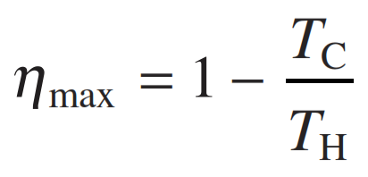
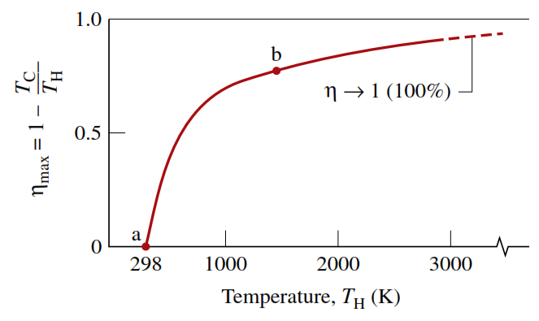
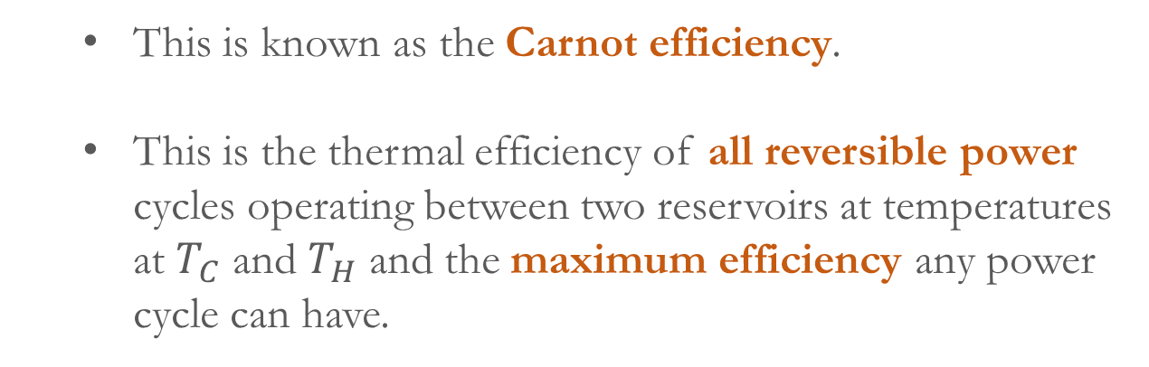
    Maximum theoretical efficiency and COP:
    With the temperatures evaluated on the Kelvin scale, maximum theoretical efficiency is
    This is known as the Carnot efficiency.
    This is the thermal efficiency of all reversible power cycles operating between two reservoirs at temperatures at $T_{C}$ and $T_{H}$ and the maximum efficiency any power cycle can have.
    By inspection, the value of the Carnot efficiency increases as $T_{H}$ increases and/or $T_{C}$ decreases (Figure).

Slide 13
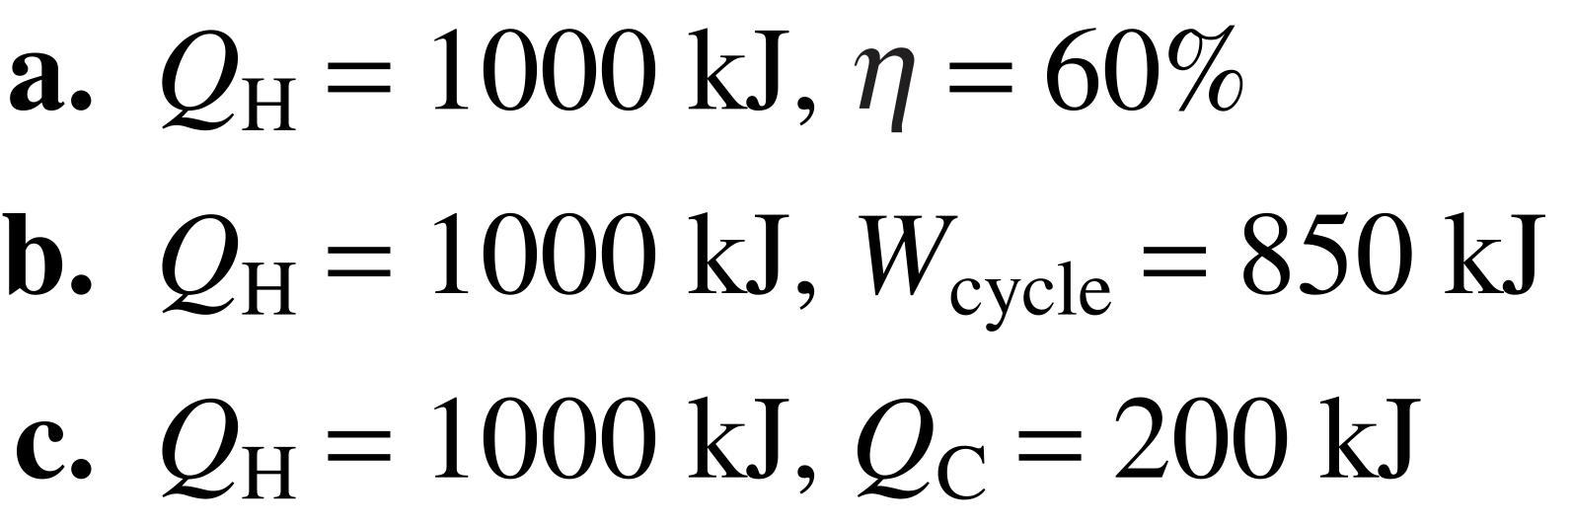
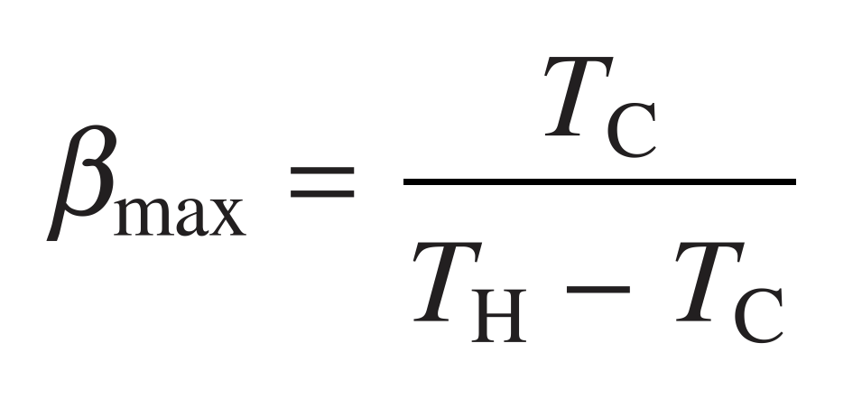
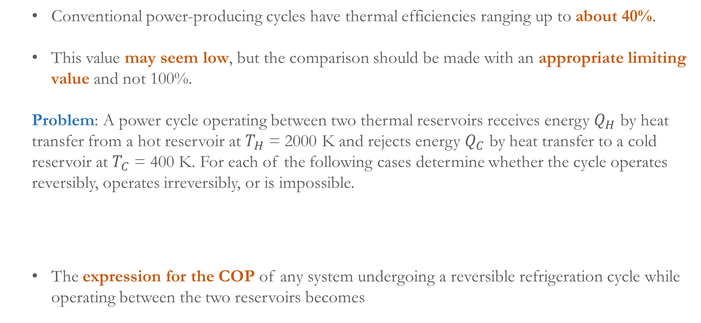
    Conventional power-producing cycles have thermal efficiencies ranging up to about 40%.
    This value may seem low, but the comparison should be made with an appropriate limiting value and not 100%.
    Problem: A power cycle operating between two thermal reservoirs receives energy $Q_{H}$ by heat transfer from a hot reservoir at $T_{H}$ = 2000 K and rejects energy $Q_{C}$ by heat transfer to a cold reservoir at $T_{C}$ = 400 K. For each of the following cases determine whether the cycle operates reversibly, operates irreversibly, or is impossible.
    The expression for the COP of any system undergoing a reversible refrigeration cycle while operating between the two reservoirs becomes

Slide 14
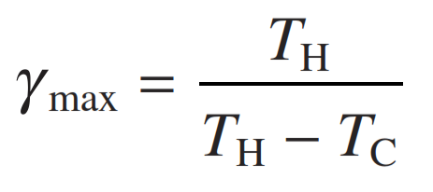
    The expression for the COP of any system undergoing a reversible heat pump cycle while operating between the two reservoirs becomes
    As for the case of the Carnot efficiency, these expressions can be used as standards of comparison for actual refrigerators and heat pumps.
    Carnot cycle:
    The Carnot cycles are the theoretical ideal thermodynamic cycles proposed by French physicist Sadi Carnot. It represents reversible cycles operating between two thermal reservoirs.
    The system executing the cycle undergoes a series of four internally reversible processes: two adiabatic processes alternated with two isothermal processes.

Slide 15
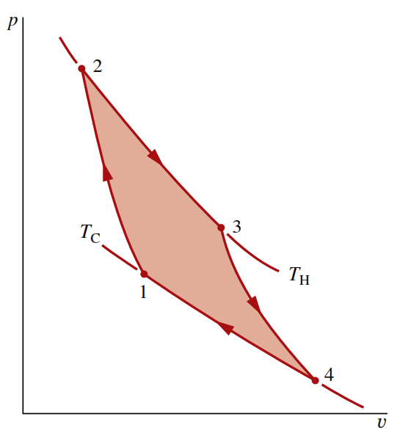
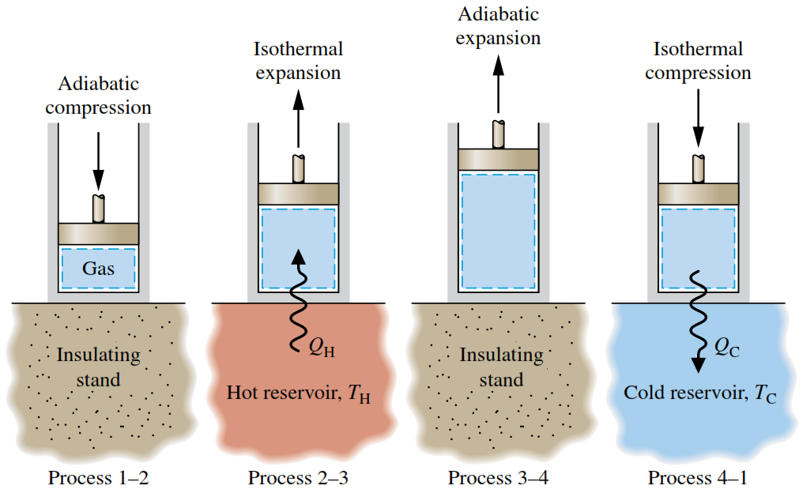
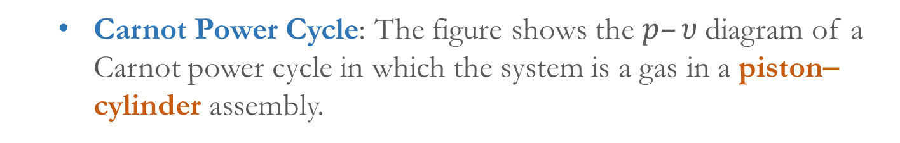
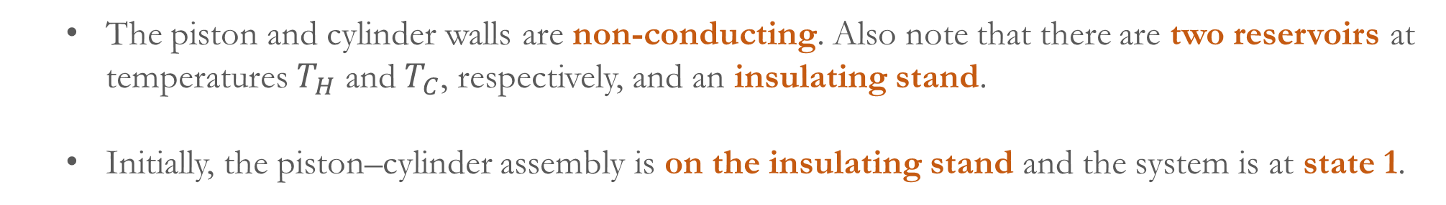
    Carnot Power Cycle: The figure shows the $p–υ$diagram of a Carnot power cycle in which the system is a gas in a piston–cylinder assembly.
    The piston and cylinder walls are non-conducting. Also note that there are two reservoirs at temperatures $T_{H}$ and $T_{C}$, respectively, and an insulating stand.
    Initially, the piston–cylinder assembly is on the insulating stand and the system is at state 1.

Slide 16
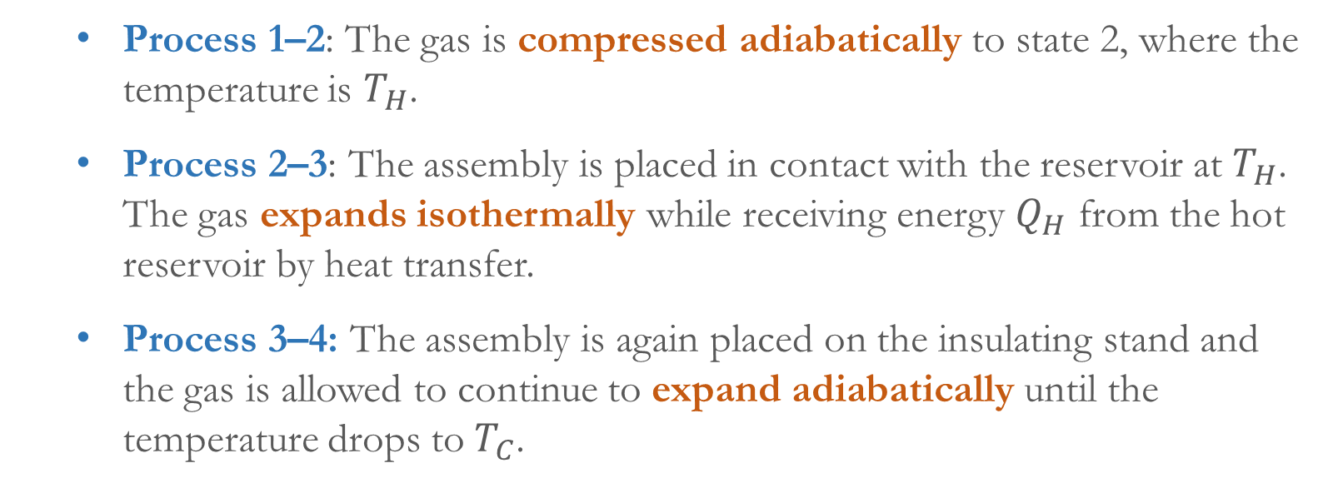
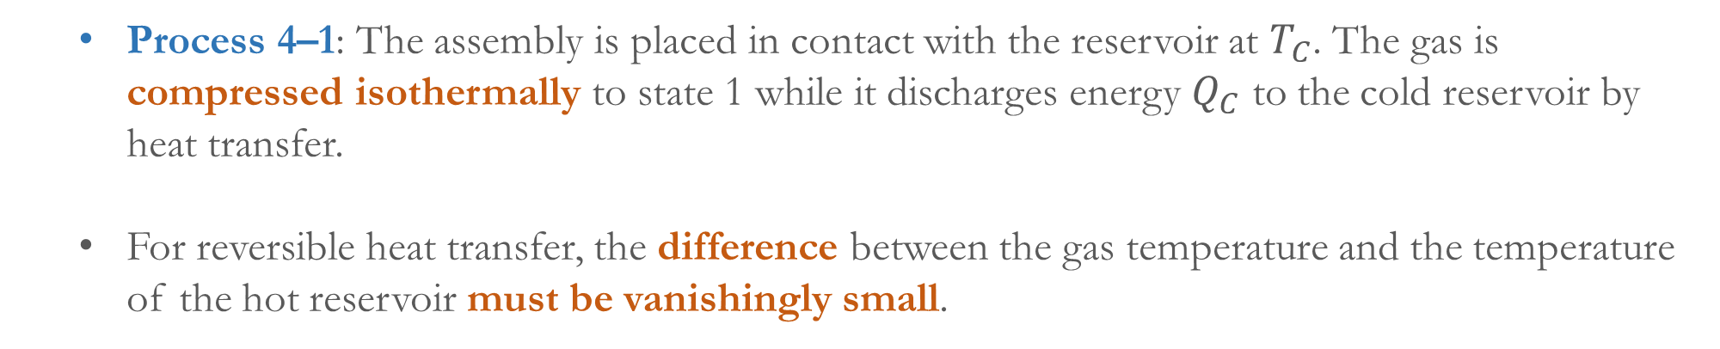
    Process 1–2: The gas is compressed adiabatically to state 2, where the temperature is $T_{H}$.
    Process 2–3: The assembly is placed in contact with the reservoir at $T_{H}$. The gas expands isothermally while receiving energy $Q_{H}$ from the hot reservoir by heat transfer.
    Process 3–4: The assembly is again placed on the insulating stand and the gas is allowed to continue to expand adiabatically until the temperature drops to $T_{C}$.
    Process 4–1: The assembly is placed in contact with the reservoir at $T_{C}$. The gas is compressed isothermally to state 1 while it discharges energy $Q_{C}$ to the cold reservoir by heat transfer.
    For reversible heat transfer, the difference between the gas temperature and the temperature of the hot reservoir must be vanishingly small.

Slide 17
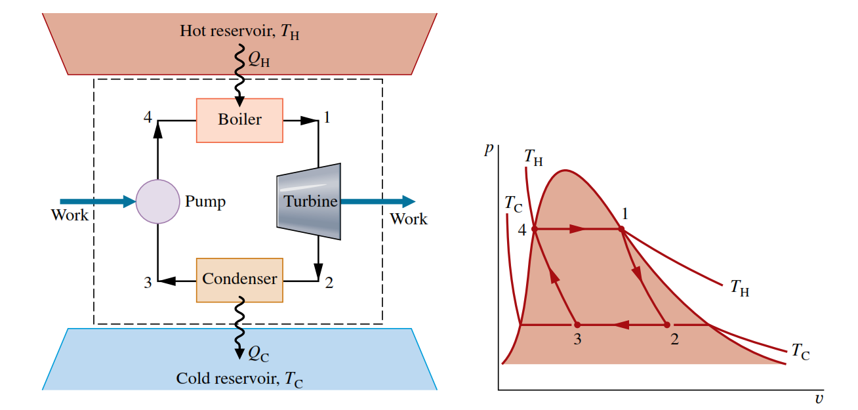
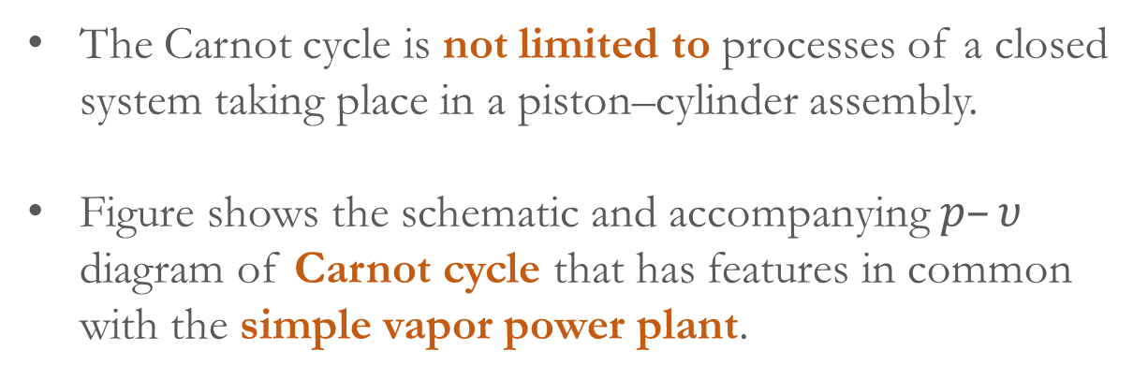
    The enclosed area on the $p–υ$ diagram, shown shaded, is the net work developed by the cycle per unit of mass.
    The Carnot cycle is not limited to processes of a closed system taking place in a piston–cylinder assembly.
    Figure shows the schematic and accompanying $p–υ$ diagram of Carnot cycle that has features in common with the simple vapor power plant.
    Boiler: Isothermal heat transfer, Phase change, constant pressure (4-1)
    Turbine: Adiabatic expansion, Decrease in temperature and pressure (1-2)
    Condenser: Isothermal heat transfer, Phase change (partially), constant pressure (2-3)
    Pump (Compressor): Adiabatic compression, Increase in temperature and pressure (3-4)

Slide 18
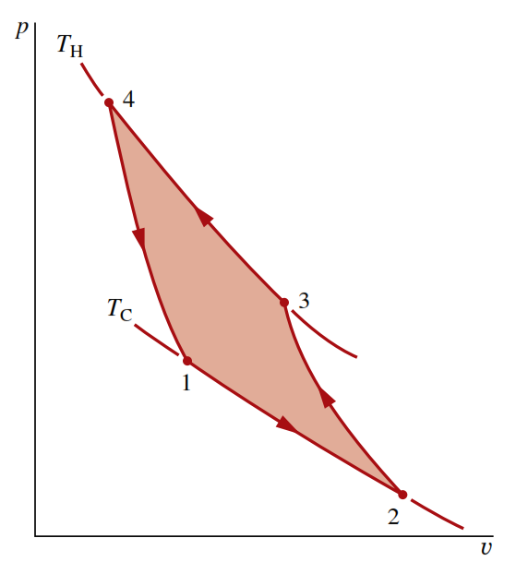
    Carnot Refrigeration and Heat pump cycles: If a Carnot power cycle is operated in the opposite direction, the magnitudes of all energy transfers remain the same but the energy transfers are oppositely directed.
    Such a cycle may be regarded as a reversible refrigeration or heat pump cycle.
    The processes of Carnot refrigeration or heat pump cycle can be found by yourself.
    In the case of the cycle shown in figure, the shaded area represents the net work input per unit of mass.
    Carnot cycles also can be devised that are composed of processes in which a capacitor is charged and discharged, a paramagnetic substance is magnetized and demagnetized, and so on.

Slide 19
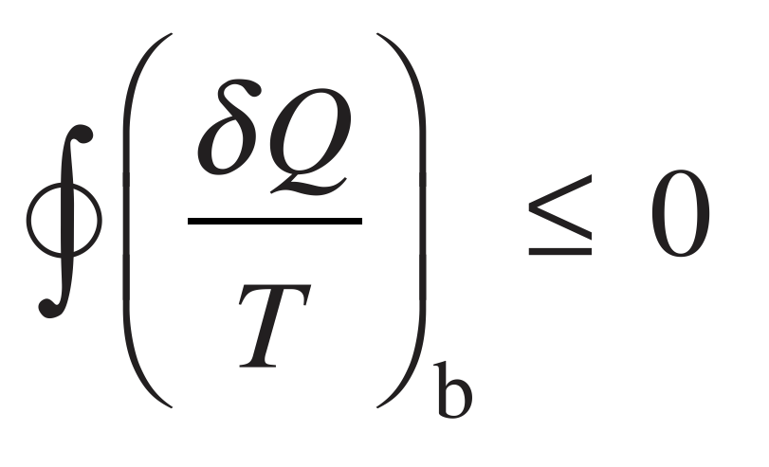
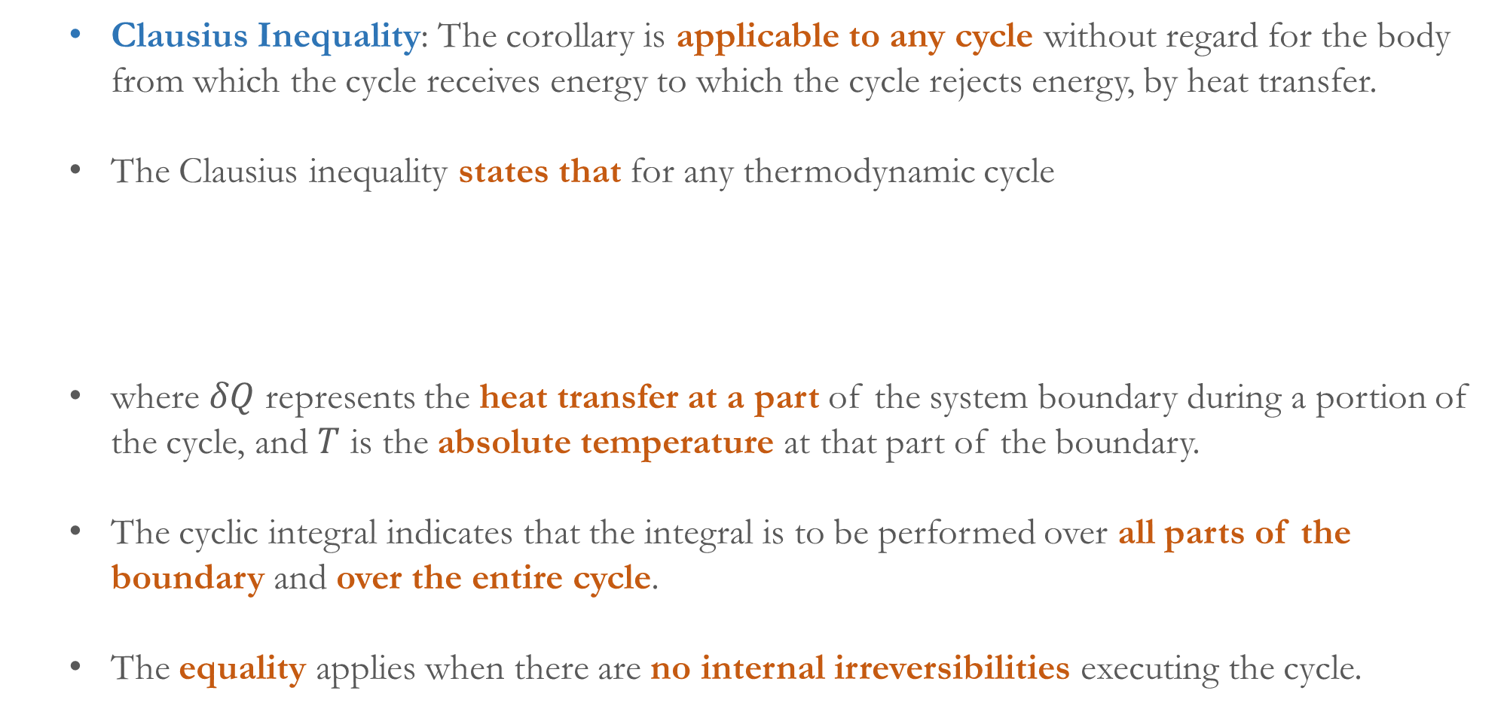
    Clausius Inequality: The corollary is applicable to any cycle without regard for the body from which the cycle receives energy to which the cycle rejects energy, by heat transfer.
    The Clausius inequality states that for any thermodynamic cycle
    where $δQ$ represents the heat transfer at a part of the system boundary during a portion of the cycle, and $T$ is the absolute temperature at that part of the boundary.
    The cyclic integral indicates that the integral is to be performed over all parts of the boundary and over the entire cycle.
    The equality applies when there are no internal irreversibilities executing the cycle.

Slide 20
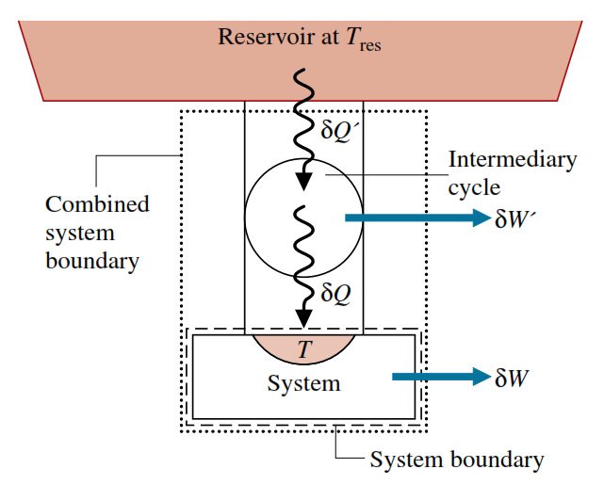
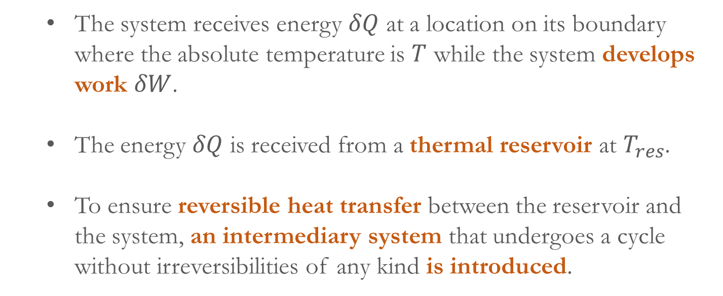
    The inequality applies when internal irreversibilities are present.
    The Clausius inequality can be demonstrated using the Kelvin–Planck statement of the second law.
    The system receives energy $δQ$ at a location on its boundary where the absolute temperature is $T$ while the system develops work $δW$.
    The energy $δQ$ is received from a thermal reservoir at $T_{res}$.
    To ensure reversible heat transfer between the reservoir and the system, an intermediary system that undergoes a cycle without irreversibilities of any kind is introduced.
    The cycle receives energy $δQ′$ from the reservoir and supplies $δQ$ to the system, producing work $δW′$.

Slide 21
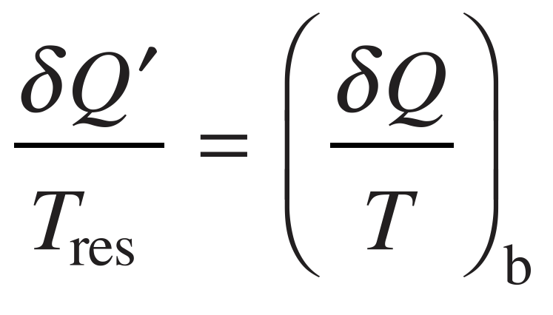
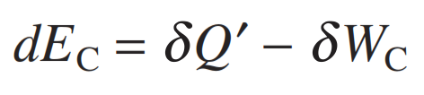
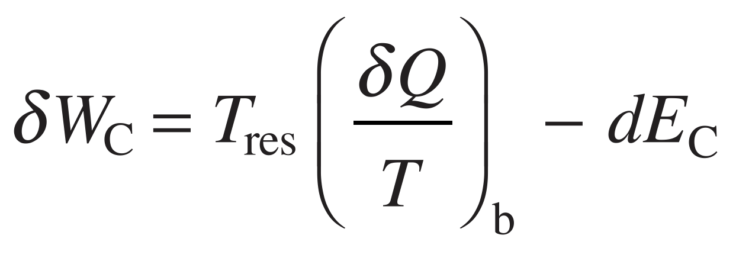
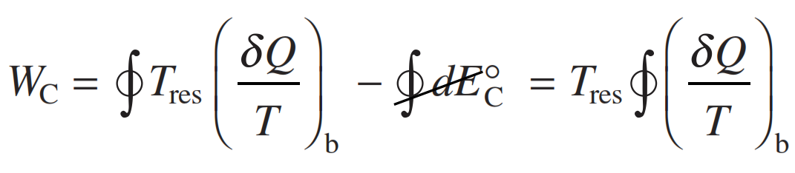
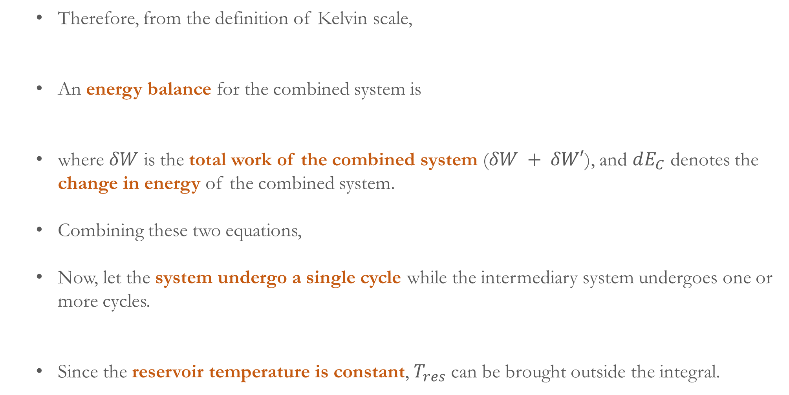
    Therefore, from the definition of Kelvin scale,
    An energy balance for the combined system is
    where $δW$ is the total work of the combined system ($δW + δW′$), and $dE_{C}$ denotes the change in energy of the combined system.
    Combining these two equations,
    Now, let the system undergo a single cycle while the intermediary system undergoes one or more cycles.
    Since the reservoir temperature is constant, $T_{res}$ can be brought outside the integral.

Slide 22
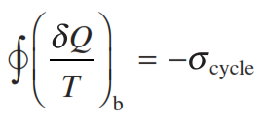
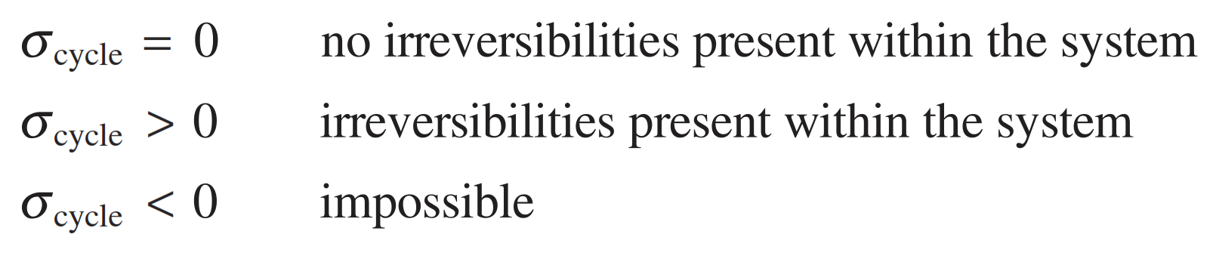
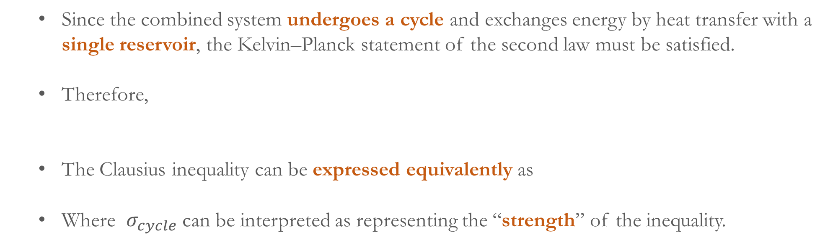
    Since the combined system undergoes a cycle and exchanges energy by heat transfer with a single reservoir, the Kelvin–Planck statement of the second law must be satisfied.
    Therefore,
    The Clausius inequality can be expressed equivalently as
    Where $σ_{cycle}$ can be interpreted as representing the “strength” of the inequality.

